Slide 1
The Pediatric Patient on High Flow: When to Intervene and When to Wean
Wendy Wheeler MA,BSN,RN,EMT,CEN,CPEN, NHDP-BC
Notes:
Hello my name is Wendy Wheeler and I am happy to be here today with you to talk about the use of High flow oxygen in pediatric patients.my back ground is I have 19 years of Emergency nursing and I am currently a critical care transport nurse at Connecticut Childrens doing inter facilty transport of infants and children.

Slide 2
Pediatric Illness
A common reason for children to present to the Emergency Department (ED) is for respiratory illness.
Illness may range from a viral illness such as Respiratory Syncytial Virus (RSV) to bacterial pneumonia.
With a range of treatments
Notes:
We see many children with respiratory illnesses throughout the year with peaks in spring and fall, although in my area we have noticed an increase at an earlier time form typical start. Respiratory illnesses can be viral of bacterial but will need some of the same interventions.

Slide 3
On Assessment
Cough
Increased respiratory rate
Increased respiratory effort
Wheezing
Decrease in Air Movement
Retractions

Slide 4
Treatments
Nebulized medications
Steroids
Suction
High Flow Oxygen
CPAP
Intubation
Notes:
As you can see there are many tools we have to chose from. We must evaluate the need to best help a child to not need intubation. While this list has many things there are more that maybe needed such as antibiotics. We don’t always need the bigger resources such as high flow when a simple nasal cannula may work. But we are here to speak specifically about high flow oxygen.

Slide 5
When to Intervene
When common treatments aren’t enough
  Suction, steroids, nebulized treatments
When a child’s work of breathing is not improving
  Nasal flaring, retractions, increased respiratory rate
When signs of respiratory distress are continuing and worsening
  Grunting , inspiratory stridor, head bobbing
Notes:
So when do we intervene ? Just like in the adult world a good assessment is needed. And frequent reevaluation is key. Knowing what normal pediatric vital signs are and how to assess child is important.

Slide 6
When it may be too late
The patient in Distress may quickly move to Respiratory Failure
Signs of failure
Apnea
Bradypnea
Bradycardia
Low o2 saturation despite oxygen

Slide 7
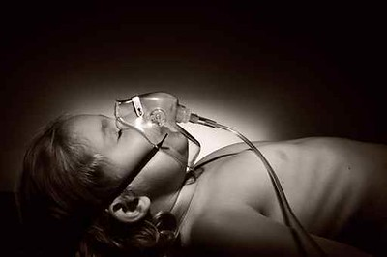
Signs to Watch for
Increased work of breathing
Nasal flaring
Grunting
Retractions
  Intercostal
  Subcostal
  Supraclavicular
  Tracheal tugging
https://www.flickr.com/photos/tannwander/15566986890/in/photolist-pHASRG-bb7UC4-ppq3ka-5Jff4a-dMPiWA-5Jjvss-huA7CF-awYjn9-huAnkh-huMpW4-bW4eo9-5s9Up-2nntwhs-huKVS3-2nDd3YB-2iEa7f6-huAgjP-2kTZbW9-2gUTK3h-p4hth9-2jHbjiB-2ne26hf-2njdb9T-pdka7e-2ndZKuU-2neJvsM-p4gTgA-huAZvm-huM9Pb-2ah7Tu-huKTcJ-huMntP-2jHCsk7-2nfcVW8-2kxVwn6-huM6Jy-9mSzJR-huB2oE-huKNeX-2j5TtpX-huAcXt-2kZrkEB-huBRn4-huMn5T-2iHy3oJ-huMTqH-8DK4Mj-huBG6t-2n647jt-huBQV2
Notes:
When you go into a room and see a child like this what do you think? What should we do next?

Slide 8
How Does High Flow Work
HFNC devices have shown the ability to increase functional residual capacity (FRC), or lung volume at end expiration
  Evidence suggests that HFNC devices provide some level of PEEP, but it is not directly set
  Possible mechanism of action for improved WOB
  Many factors must be considered to understand the amount of PEEP provided.
Notes:
While High flow may or may not help to improve PEEP, it does help with gas exchange in the lungs

Slide 9

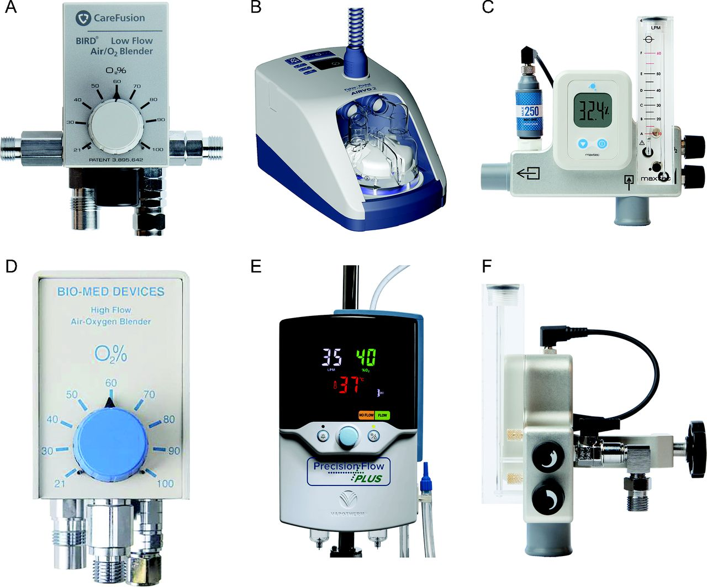
What do you use?
There are many brands of High Flow equipment.
Notes:
There are many different brands of high flow equipment. Know what your hospital uses. Become familiar with them and know your hospital protocols

Slide 10
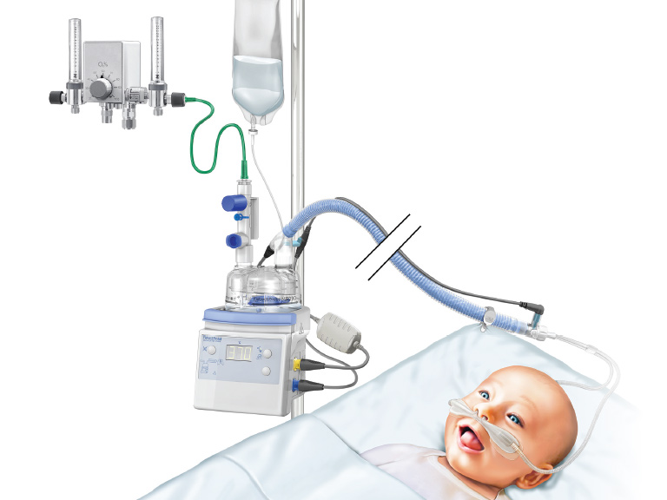
Connecticut Children’s
This is an illustration of what we use at my hospital.
Notes:
This is an illustration of what we use at my hospital. We use a similar set up along with our ventilator while in transport. Some of the benefits of using high flow oxygen are increased patient comfort, is non-invasive and patients can continue to talk, eat and drink

Slide 11

What needs to be considered?
  Cannula size
    Mouth open/closed
    Liter flow
In short, patients can receive little PEEP, sufficient PEEP, or excessive PEEP depending on these factors, and must be monitored diligently
Notes:
At my hospital for a patient to be on a med/surg floor we have a flow rates of less than or equal to 3LPM/kg ( Max of 45LPM) for flow rates above an attending must be consulted. Max FiO2 of 50%

Slide 12
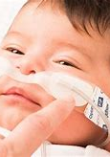
Sizing
Nares should not be fully Occluded
  May cause excessive airway pressures
  May cause difficulty exhaling
  May cause septal breakdown

Slide 13
Humidification
With the use of warm humidified oxygen, the patient has less of a metabolic cost to warm the air inhaled.
The humidifier warms inspired gas, working as an artificial nose for patients on HFNC support
Humidity and temperature control/promote secretion hydration, cilia movement, and normal physiologic airway conditions
High flow rates must be humidified to a temperature recommended because the nose is unable to compensate
Notes:
Humidification lessened the energy required and showed weight gain compared to infants on CPAP. Instead of using up energy to warm the gases they used it to grow

Slide 14
Other Treatments
Along with High Flow should be other treatments:
  Aerosolized hypertonic saline
  Chest Physiotherapy
  Deep Suction
  Care should be clustered so that the child may have periods of rest
  Along with the treatments the patient should be on a continuous cardiac monitor with continuous pulse oximetry.
Notes:
There are any other treatments that can be or should be used in conjunction with the high flow oxygen. Keeping in mind that we needed to go to this due to routine measures needing help. Aerosolized hypertonic saline, chest physiotherapy,and deep suctioning of secretions. Knowing a child needs these interventions is key but we must also allow for rest and less stress to help then to get well so clustering of care should be arranged. One way to continuously sasses them is to place them on a central monitor with pulse oximetry so they can be watch from outside the room and while at rest.

Slide 15
When to wean support
Start decreasing the flow when Work of Breathing (WOB) has improved to mild to moderate rate, The heart rate and respiratory rate may still be elevated for the patients age but is stable.
Continue to wean If WOB continues to improve and patient remains comfortable.
When supplemental oxygen can be weaned to lowest level to maintain SpO2 of 92%
Notes:
When we go to start weaning a patient it may not work. We must evaluate the patient before and during the wean to make sure they remain stable. Keeping in mind it is not just their vital signs but also their work of breathing that must be evaluated. They may not and probably won’t have a oxygen saturation of 100% at first as you start to wean but we must aim for a saturation of 92% or more.

Slide 16
Our clinical pathway
You can find the pathway my hospital uses for the use of High Flow oxygen outside of the Pediatric Intensive Care Unit along with many more for other pediatric illnesses on the internet.
Do a search for Connecticut Childrens Clinical Pathways

Slide 17
References
https://www.clinicalkey.com/service/content/pdf/watermarked/1-s2.0-S0954611109001322.pdf?locale=en_US&searchIndex=
Dysart K, Miller TL, Wolfson MR, Shaffer TH. Research in high flow therapy: mechanisms of action. Respiratory Med. 2009;103(10):1400-5.
Franklin D, Babl FE, Schlapbach LJ, Oakley E, Craig S, Neutze J, et al. A randomized trial of high-flow oxygen therapy in infants with bronchiolitis. N Engl J Med. 2018 Mar;378(12):1121-1131.
Kawaguchi A, Yasui Y, deCaen A, Garros D. The clinical impact of heated humidified high-flow nasal cannula on pediatric respiratory distress. Pediatr Crit Care Med. 2017 Feb;18(2):112-119.

